Slide 1
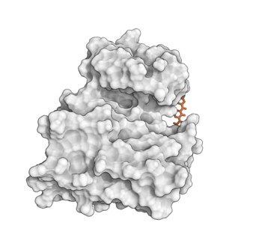
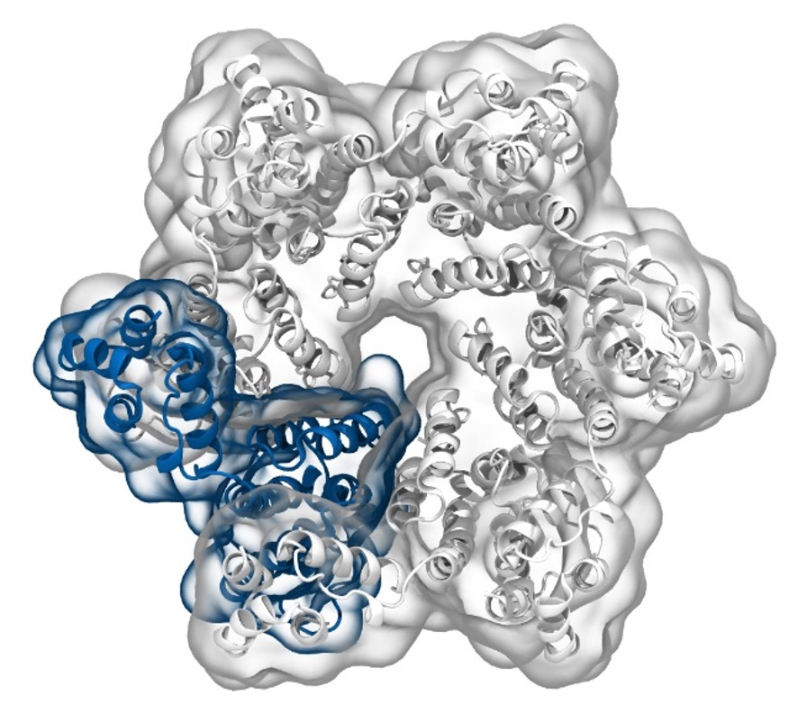
Simulation of Biomolecules
Markov State Modelling
2024 CCP5 Summer School
Dr Matteo Degiacomi
Durham University
matteo.t.degiacomi@durham.ac.uk
Dr Antonia Mey
University of Edinburgh
antonia.mey@ed.ac.uk

Slide 2
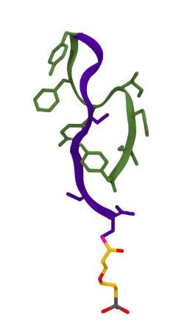
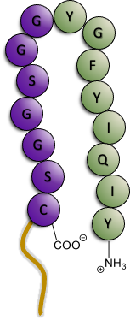
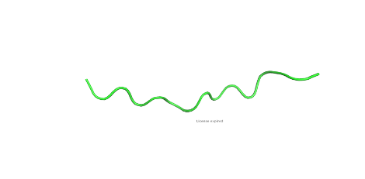
Markov State Modelling (MSM)
Can we predict the equilibrium structure of a peptide?
AlphaFold
suggestion
Run 5 μs molecular dynamics simulation
Use a Markov Model to identify dominant conformations in solution
Report most stable structure
2

Slide 3
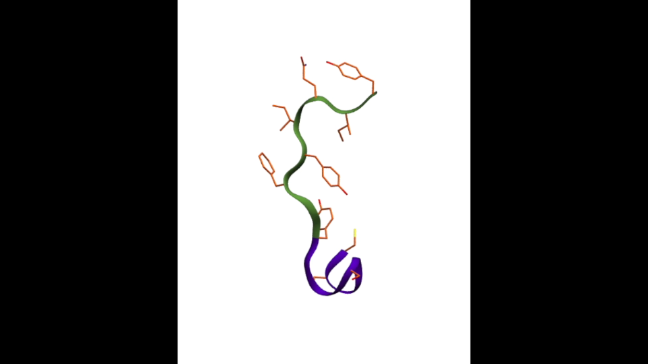
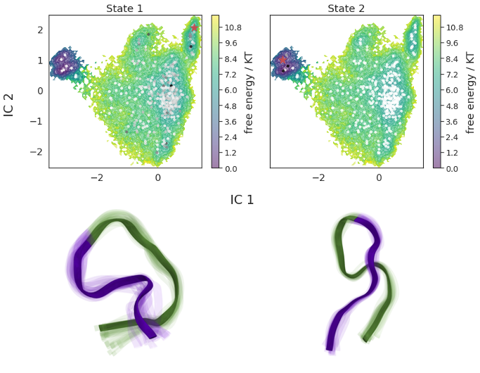
MSMs allow for quantitive data from molecular simulations
YITIY TAYAG SGGSC
Clustering is the first step towards a model providing quantitive equilibrium and kinetic information from the simulation
Time
20%
80%
Protein dynamics
Simulation movie
Probabilistic understanding of the trajectory
[…] Ryan Zhu, A. Mey […], Viruses, 2023
3

Slide 4
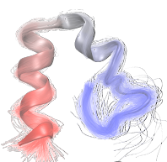
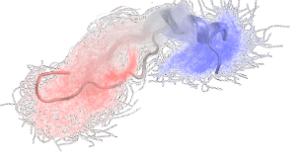
Frogs jumping and proteins moving
Over the period of a day:
What do a protein and a frog jumping have in common?
1
2
1
2
4
3
4

Slide 5
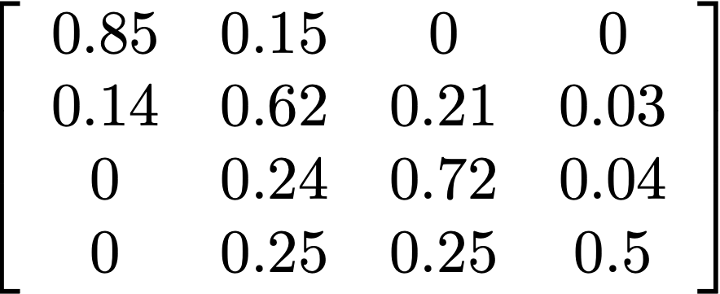
What is a Markov chain?
Over the period of a day:
1
2
Sample
Estimate
4
3
5

Slide 6
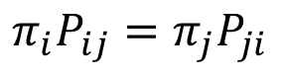
What is a Markov chain?
Transition matrices are:
Stochastic matrices
Containing conditional jump probabilities
If they are irreducible and ergodic:
They have a stationary probability
Has a stationary probability π.
The stationary probability is the eigenvector of the eigenvalue λ₁
Sample
Estimate
If they are reversible
$$π_{i}P_{ij}=π_{j}P_{ji}$$
6

Slide 7
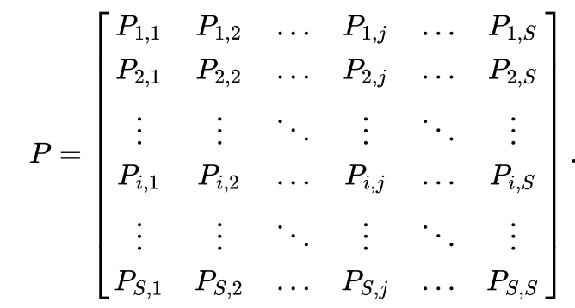
How to model protein dynamics using a Markov approach?
Approximate with a transition matrix from the trajectory:
?
7

Slide 8
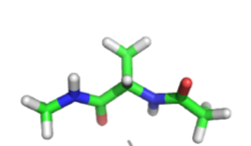
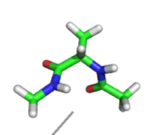
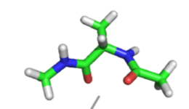
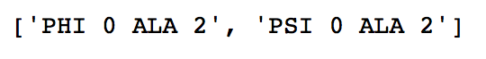
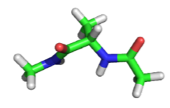
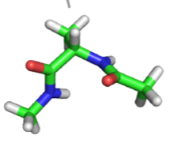
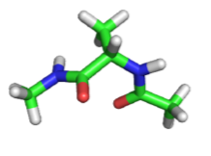
Dimensionality reduction is (often) needed for MSM
φ
ψ
ψ
ψ
Alanine dipeptide
φ
φ
8

Slide 9
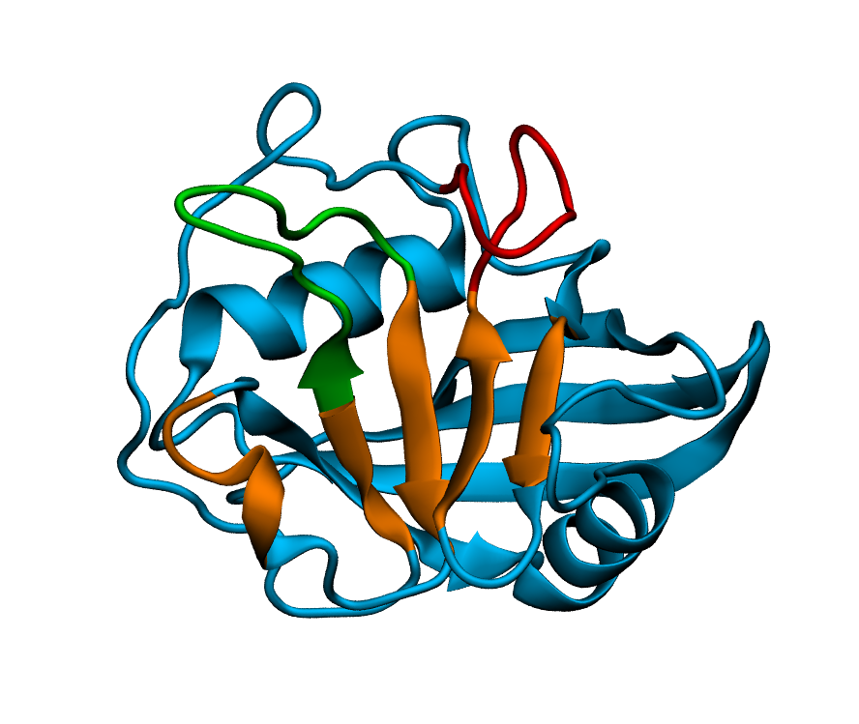
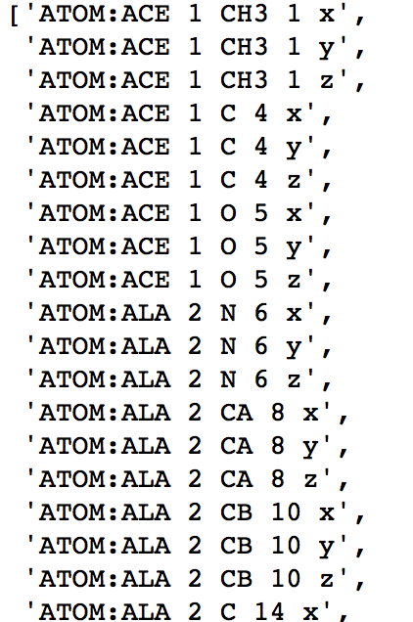
Dimensionality reduction is (often) needed for MSM
9

Slide 10
Dimensionality reduction — TICA, PCA, VAMP
Project features onto low dimensional subspace
PCA: Linear combination of input features maximising the variance
TICA: Linear combination of input features maximising time autocorrelation
VAMP: Variational approach for Markov Process, true for non-equilibrium data
VAMP: W. Chen et al., J. Chem. Phys., 2019
10

Slide 11
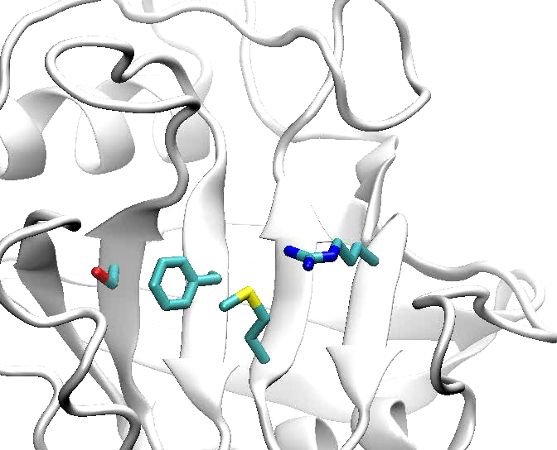
Building a Markov Model requires several steps
Featurization
(select
features)
Dimensionality Reduction
(tICA)
MD
data
Discretization
(k-means)
Discrete
Trajectories
1
2
3
4
1
MSM estimation
(MLE)
MSM validation
(ITS convergence &
CK test)
2
3
MSM
4
11

Slide 12
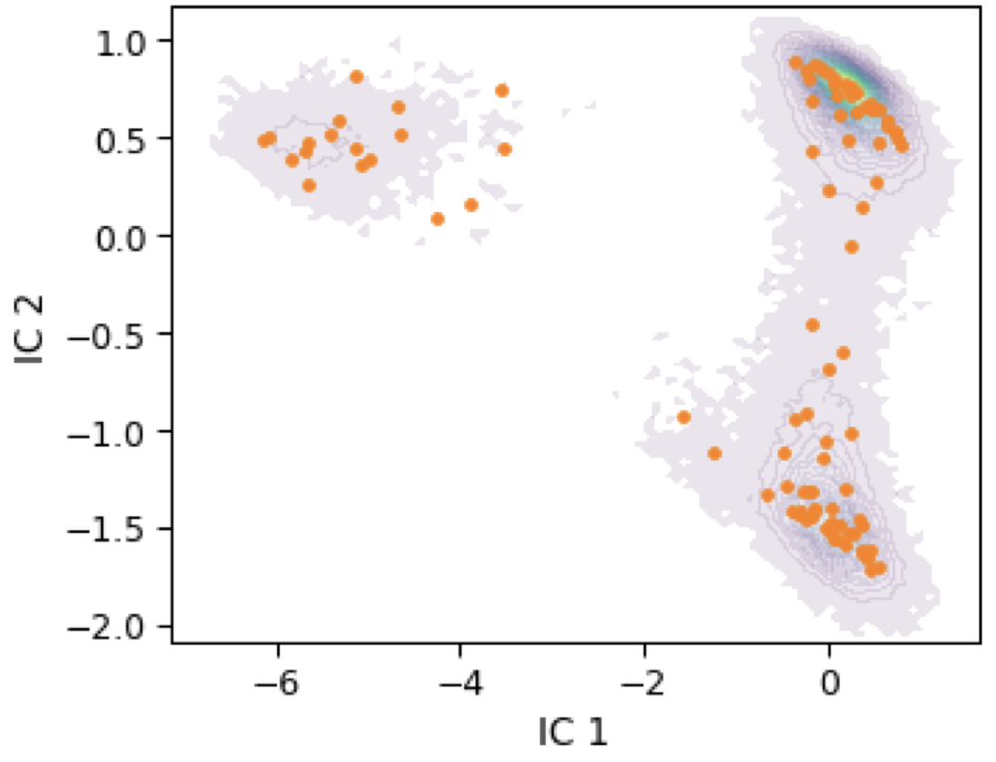
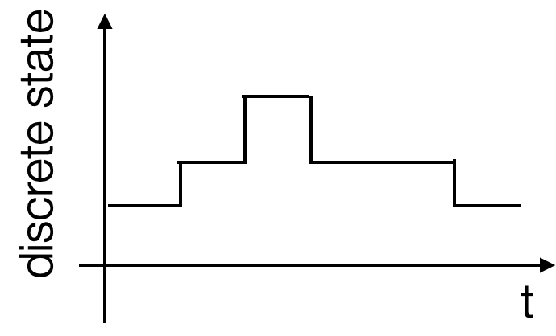

Clustering on reduced dimensional space
k-means
regular spatial
etc.
Dimensionality reduction and discretisation require a lot of parameter optimisation. It is necessary to spend a good amount of time on hyper parameter optimisation.
12

Slide 13
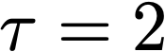
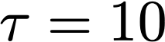
The transition matrix contains all quantative properties
Approximate with a transition matrix from the trajectory:
ç
ç
ç
varying the lag time
A
B
C
D
A
B
v
=
λ
v
right eigenvector
P
left eigenvector
P^{T}
v
=
λ
v
0
A
25
B
50
C
75
D
100
We can find the most likely structure/coordinates!
13

Slide 14
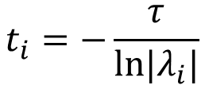
Eigenvalues tell us about timescales
gap
$$t_{i}=−\frac{τ}{ln|λ_{i}|}$$
Prinz, J.-H. et al (2011) Markov models of molecular kinetics: Generation and Validation. J. Chem. Phys., 134 . p. 174105.
14

Slide 15
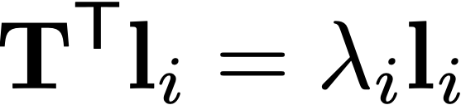
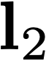
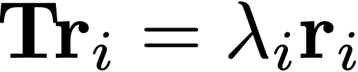
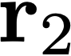
The eigenvectors tell us about the slowest processes
0
A
25
B
50
C
75
D
100
15

Slide 16
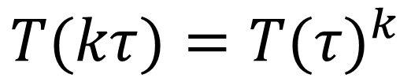
Validation with the Chapman-Kolmogorov (CK) test
$$T(kτ)=T(τ)^{k}$$
16

Slide 17
Conformational dynamics of a peptide
Can we predict the equilibrium structure of a peptide?
AlphaFold
suggestion
Run 5 μs molecular dynamics simulation
Use a Markov Model to identify dominant conformations in solution
Report most stable structure
20%
80%
[…] Ryan Zhu, A. Mey […], Viruses, 2023
17

Slide 18
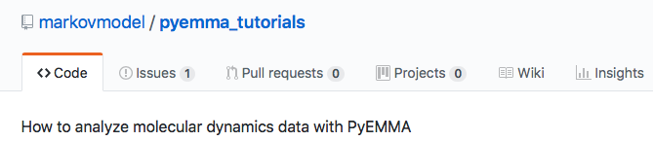
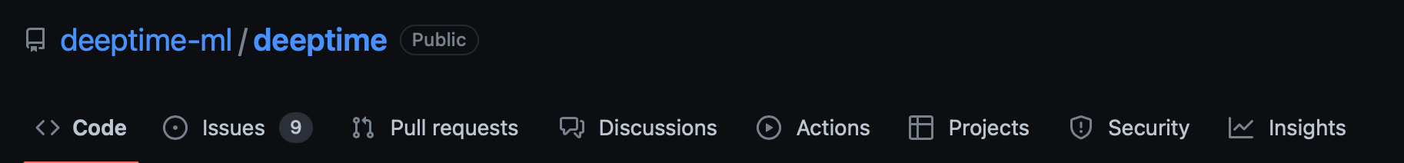
Python tools are available for building MSMs
https://www.livecomsjournal.org
https://github.com/markovmodel/pyemma_tutorials
https://github.com/deeptime-ml/deeptime
18

